Slide 1



Introduction to Survival Analysis Kaplan-Meier Survival Curves & Cox PH Models
Kowalski, analysis!
Remember to download the data and code, Skipper!
Florida Entomological Society Annual Meeting 2026
St. Augustine
July 15th, 2026
Notes:
[Optional POLL]
Question 1: Have you performed a survival analysis before
Question 2: Does your own research include a time-to-event component?

Slide 2
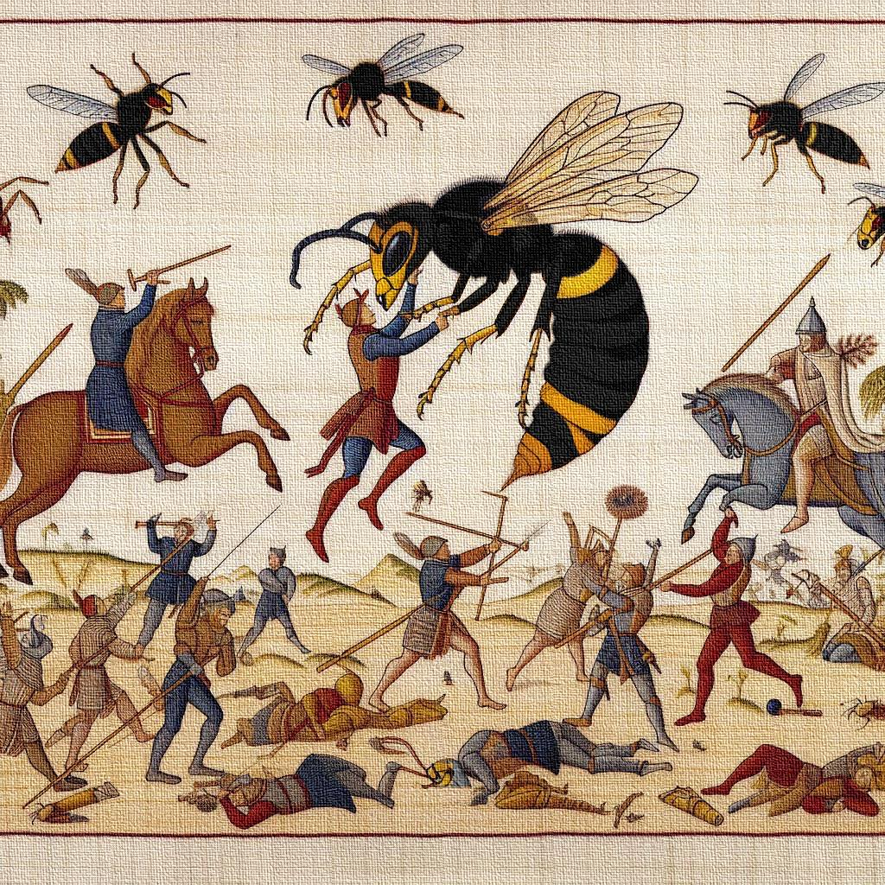
Today
Theory
Basic concepts of Survival Analysis
Kaplan-Meier (KM) Curves
Cox Proportional Hazards (PH) Model
R Example

Slide 3
What is survival analysis?
→ Time-to-event analysis: investigating how long it takes for an event to occur
Outcome often referred to as either survival time, failure time, or time to event
Examples in entomology:
Insecticide Susceptibility & Toxicology e.g., time until insect death after insecticide exposure
Insect Development & Life Cycle Analysis e.g., time to emergence or pupation
Impact of Biotic and Abiotic Factors e.g., time until death under different temperature regimes
Notes:
Not focused on when something happens (e.g., the specific date) but on how long it takes from a defined starting point to the event.

Slide 4
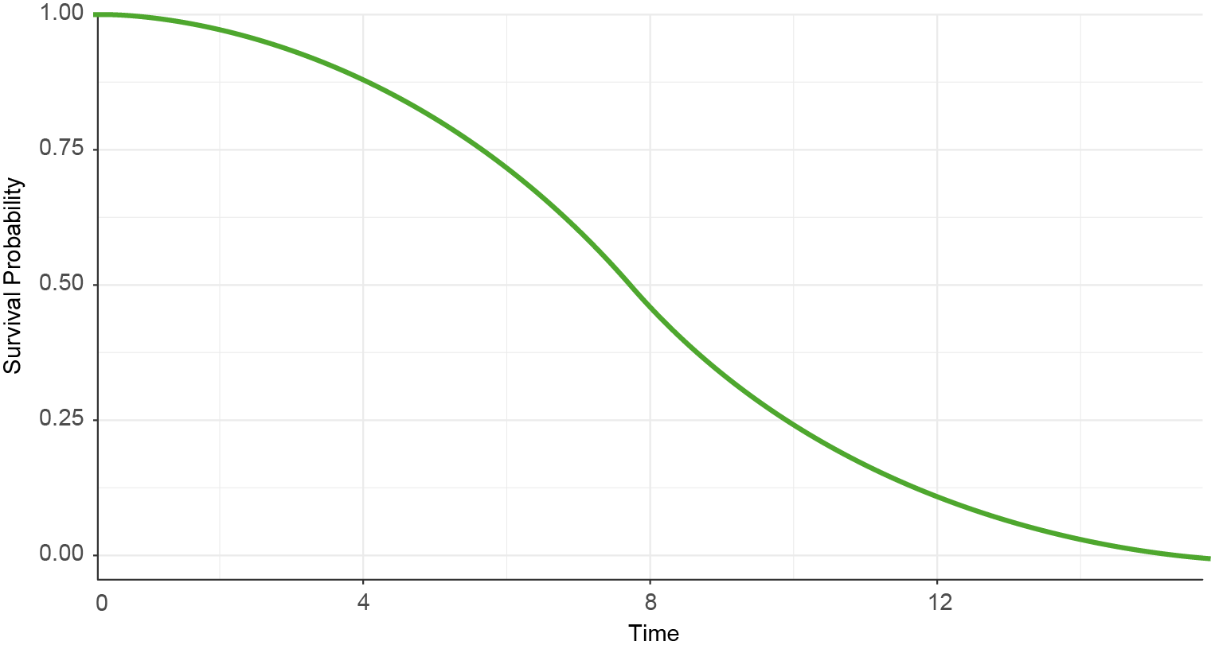



Survival function
$$S\left(t\right)=\operatorname{Pr}\left(T>t\right)=1 −P(t)$$
Survival function S(t)
$$\operatorname{Pr}\left(T>5\right)=0.817$$
Expresses the probability that a subject’s true survival* time will exceed time , i.e., that the subject will survive* beyond time t.
$$\operatorname{Pr}\left(T>10\right)=0.233$$
* i.e., probability that the subject will not have experienced the event by time t.
Notes:
The survival function gives probability of surviving to time t.
– i.e. the proportion of the population still without the event by time t.

Slide 5
Example: Survival after insecticide exposure
Information of interest: duration
Start point: first exposure to insecticide
End point: death
End time
(Event occurs)
Start time

Slide 6
Example: Survival after insecticide exposure
Information of interest: duration
Start point: first exposure to insecticide
End point (realistically):
death OR
study ends OR
subject is censored
End time
(Event occurs)
Start time

Slide 7
What is censoring?
Censoring is a type of missing data problem unique to survival analysis.
To estimate survival probability: Important to include censored data in analysis
Insecticide example
Mosquito still alive at study end
Escaped or lost during handling
Death due to unrelated reasons

Slide 8
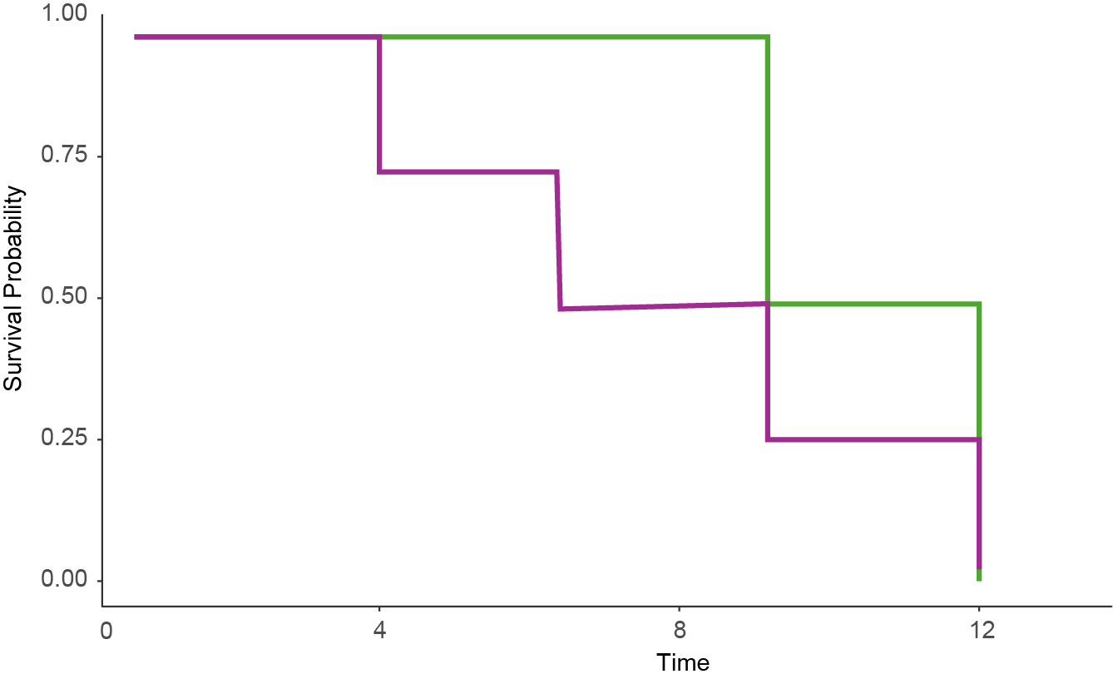
Assumption of noninformative censoring
Survival function estimated from data with informative censoring
Assumptions
subject’s censoring time not related to the unobserved survival time,
distribution of censoring times and survival times are unrelated
Survival function estimated from data with no censoring and data with non-informative censoring are the same
Notes:
non-informative: the reason we stopped observing the subject is unrelated to their likelihood of experiencing the event.
If this assumption is violated (as was the case for the data underlying the green survival curve), the survival estimates can be biased.

Slide 9
Common methods for survival analysis
 | Kaplan-Meier (KM) | Cox Proportional Hazard (PH)
Test | parametric | semi-parametric
Pros | simple to interpret can estimate S(t) | can estimate hazard ratio HR hazard can fluctuate with time
Cons | no functional mathematical form can not estimate a HR only few and categorical independent variables | can not estimate S(t)

Slide 10
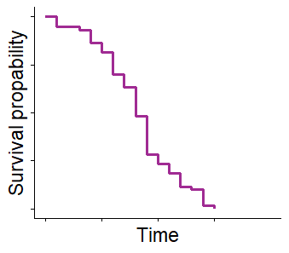
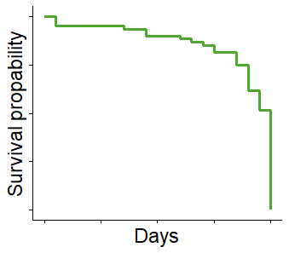
Kaplan-Meier Curves
Event Rate
Kaplan-Meier (KM) curves estimate survival probability over time
→ Visual tool to compare groups
X-axis: Time
Y-axis: Probability of survival
Each step = death event
Tick marks = censored data
Survival
Event Rate
Survival

Slide 11
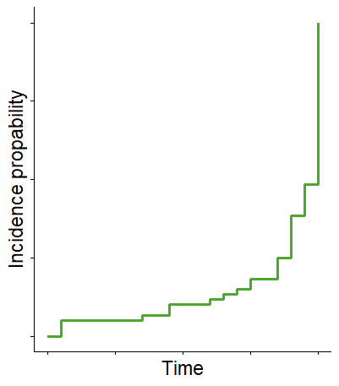
Kaplan-Meier Curves
Kaplan-Meier (KM) curves can also plot cumulative event probability (or cumulative incidence)
Cumulative events (f(y) = 1-y) if event can only be experienced once

Slide 12
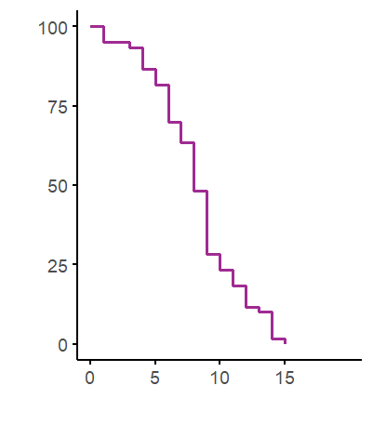
Kaplan-Meier Curves
Interpreting KM Curves
Steep = higher death rate
Flat = better survival
Tick marks = censored observations
Median survival time:
t at which 50 % of population is expected to not have experienced the event yet
50
Median survival = 8 time units

Slide 13
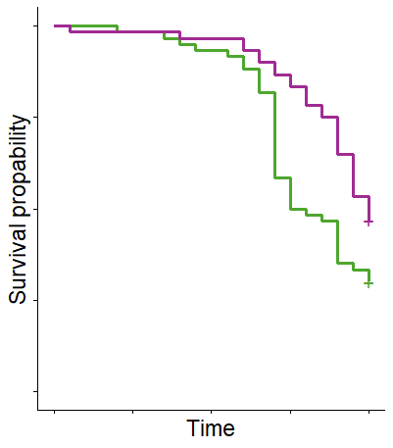
Kaplan-Meier Curves
Example: Insecticide exposure
Compare survival under 0.5% vs. 1.0% permethrin
Green line drops faster → higher mortality
0.5% Permethrin
1.0% Permethrin

Slide 14
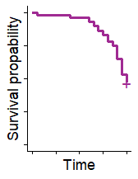
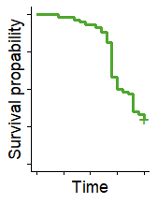
Comparing Groups
0.5% Permethrin
1.0% Permethrin
Plot KM curves for:
Resistant vs. susceptible strains
Field vs. lab mosquitoes
Different environmental conditions
But is the difference statistically significant?
→ Log-rank test
one variable at a time
does not estimate effect size or adjust for other factors
Log-Rank Test
Notes:
To quantify the differences between two survival curves, we need statistical tests.

Slide 15
Cox Proportional Hazard Model
aka Cox Regression
estimates how variables affect the hazard – or risk of event – over time.
Allows for censored data
Multiple predictors possible

Slide 16
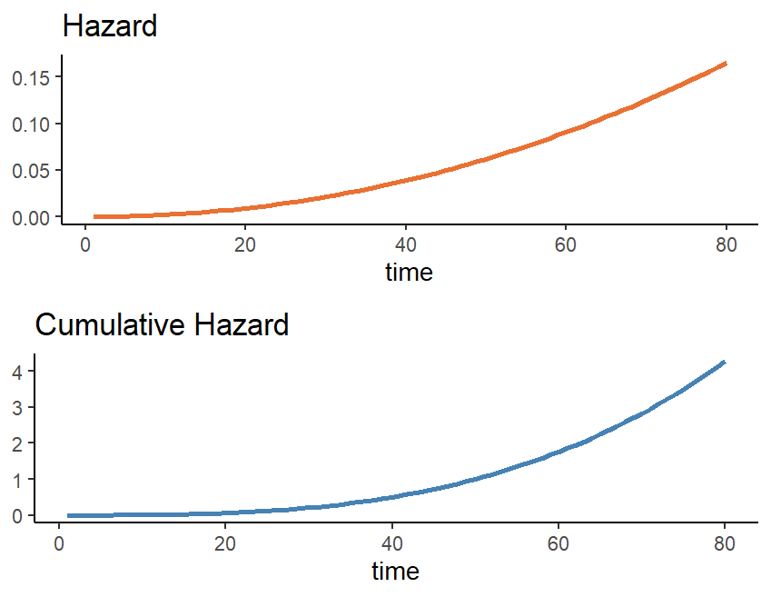
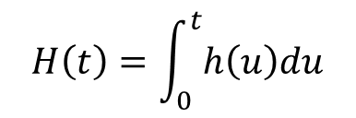

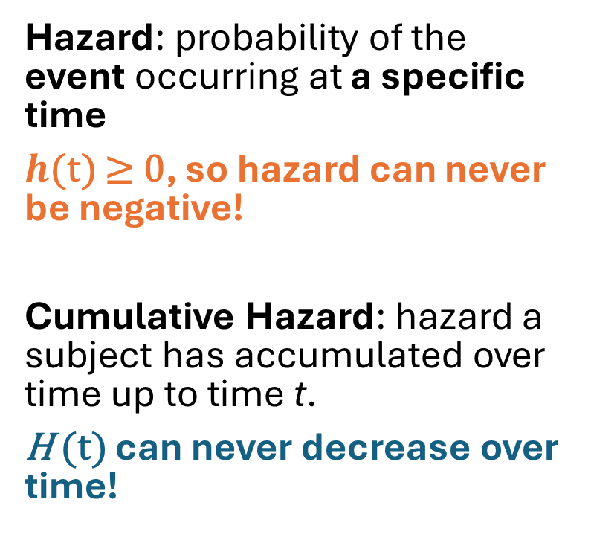
Cox Proportional Hazard Model
Hazard: probability of the event occurring at a specific time
$h$(t) ≥ 0, so hazard can never be negative!
Cumulative Hazard: hazard a subject has accumulated over time up to time t.
H (t) can never decrease over time!
$$h\left(t\right)= \frac{f(t)}{S(t−)}$$
$$H\left(t\right)=\int_{0}^{t}{h\left(u\right)du}$$

Slide 17
Cox Proportional Hazard Model
Multivariate Models
Include multiple variables:
Insecticide dose
Mosquito strain
Temperature
Age or sex
Adjust for confounding effects
Covariate: any factor that may influence the hazard function
Univariate: one variable at a time (e.g., insecticide dose only)
Multivariate: multiple variables at once (e.g., dose + strain + age)
Hazard rate = probability of event
Notes:
Multivariate models help control for confounding factors - keep both the experimental design and the biology of the system in mind.
For example: It is likely that both age and strain influence survival of mosquitoes. So, to understand the true effect of the insecticide dose, you want to include both in your model.

Slide 18
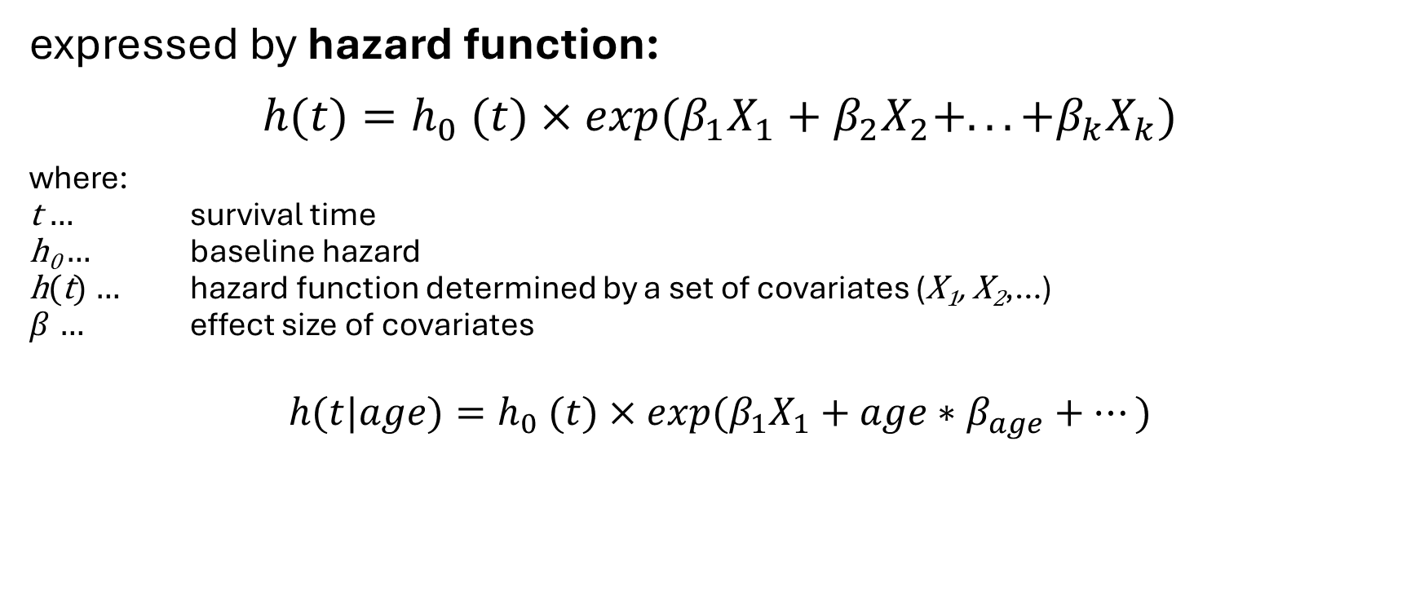
Cox Proportional Hazard Model
expressed by hazard function:
$$h(t)=h_{0} (t)×exp(β_{1}X_{1}+β_{2}X_{2}+...+β_{k}X_{k})$$
where:
t … survival time
h₀ … baseline hazard
h(t) … hazard function determined by a set of covariates (X₁, X₂,…)
$β$ … effect size of covariates
$$h(t|age)=h_{0} (t)×exp(β_{1}X_{1}+age∗β_{age}+…)$$
age at beginning of observation

Slide 19
Cox Proportional Hazard Model
Model output: Coefficients β
β indicate log hazard radio, assuming all other covariates remain constant
Example
β = 0.2 → 20% increase in the log hazard of the event per one-unit increase of covariate
β > 0: increased log hazard → higher risk
β < 0: decreased log hazard → lower risk
β ~ 0: no difference in hazard → variable has no/very little effect on survival time

Slide 20

Cox Proportional Hazard Model
Model output: hazard e^{β}
exponentiated form of the coefficient
Relative change in hazard of event for a one-unit change in covariate
Hazard ratio: hazard for a group relative to the hazard for the reference group:
$$HR= \frac{H_{x=1}}{H_{x=0}}$$
HR > 1: increased hazard
HR < 1: decreased hazard.
HR = 1: no change in the hazard

Slide 21
Cox PH Model – Output Interpretation
Covariate | Coefficient | Hazard Ratio |  | Interpretation
Insecticide_dose 0.5%, 1.0% | 0.588 | 1.8 | >1 | Risk
sex 0 if male, 1 if female | -4 | 0.0183 | <1 | rISK
strain Vero, Palm | 0.01 | 1.01 | ~1 | — rISK
HR = 1.8 for 1% vs. 0.5% permethrin
→ 80% higher risk
Notes:
HR for 1% permethrin vs. 0.5% = 1.8 → 80% higher death risk
HR for older mosquitoes = 1.5 → older mosquitoes die sooner
HR for resistant strain = 0.4 → resistance confers a survival advantage
Significant variables will have confidence intervals that don’t cross 1.

Slide 22
Cox Proportional Hazard Model Assumptions
Assumptions
Non-informative censoring
Proportional hazards
Linearity of continuous covariates i.e., effect of a covariate is constant over time
Proportional Hazard Assumptions: effect of a covariable does not change over time

Slide 23
Survival Analysis – Final Considerations
Censored data are common in ecological studies – make sure they’re accounted for.
Kaplan-Meier curves are visual, but log-rank and Cox regression provide statistical rigor.
Check assumptions! Choose other methods for time-to-event analysis if necessary, e.g.
Restricted mean survival time (RMST)
Accelerated Failure Time (AFT) regression models
Parametric survival models (see e.g., overview of Parametric Survival Modeling)

Slide 24
Worked Example Kaplan-Meier Survival Curves & Cox PH Models
Remember to download the data and code, Skipper!
Kowalski, analysis!
Notes:
[Optional POLL]
Question 1: Have you performed a survival analysis before
Question 2: Does your own research include a time-to-event component?

Slide 25

Before we get started
Data structure for survival analysis
single row per subject
single time variable measuring T time to event (or censoring time, time of last observation)
a status variable coding whether the subject experienced the event or not (censored)
variables for covariates assumed to be time-constant in this structure
Variables
time survival or censoring time
Status 0 = censored, 1 = event OR 1 = censored, 2 = event
x covariates

Slide 26
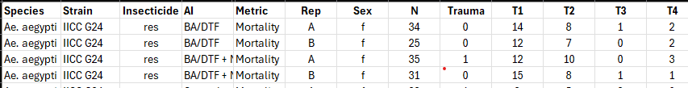
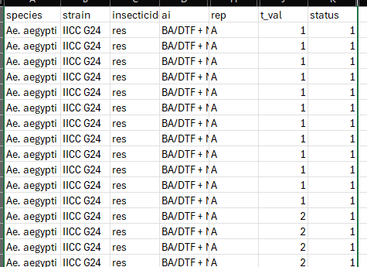
Data Format
time: t_val
status: status (0 = censored,1 = event)

Slide 27
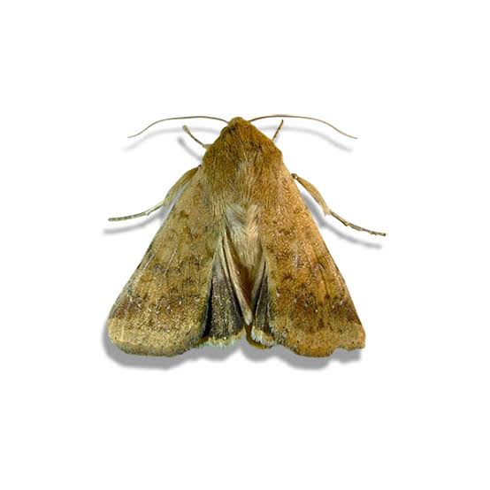
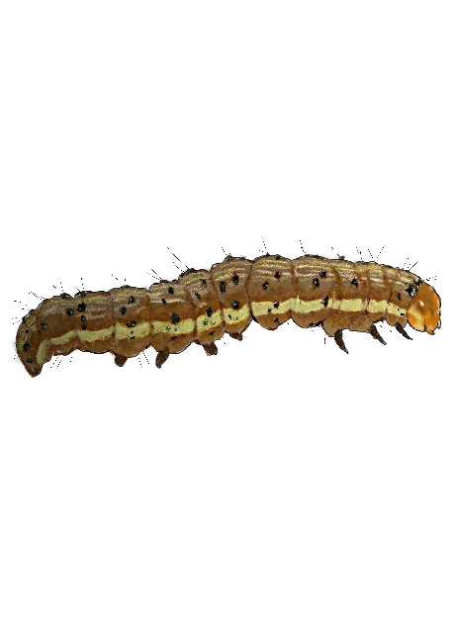
Example: Helicoverpa zea survival
Scenario: Helicoverpa zea feeding on insecticide-treated plant material. Survival was assessed daily. Insecticide residue determined after experiment was terminated.
Data:
population: Florida, Texas
time: Survival time in days until event or censoring.
status: 0 = censored, 1 = event (death)
residue: Insecticide residue (mg/cm²) on the plant material.
Notes:
Helicoverpa zea = corn earworm

Slide 28
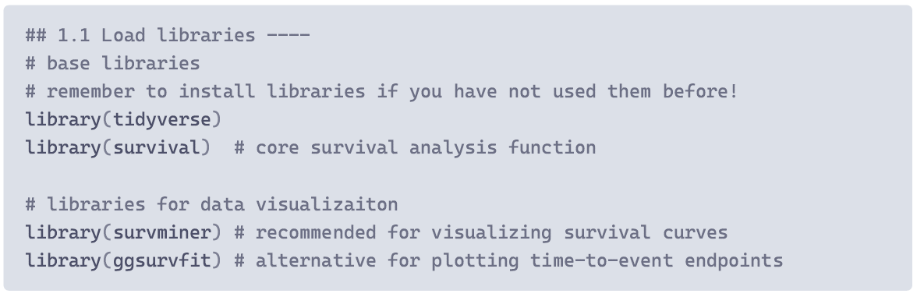
H. zea survival - Getting started
R Code:
Section #1

Slide 29
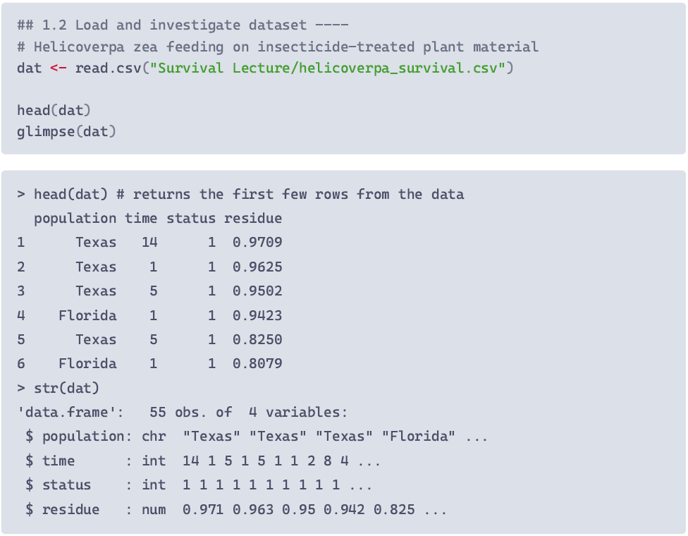
H. zea survival - Getting started
time: Survival time in days until event or censoring
status: 0 = censored, 1 = event (death)

Slide 30
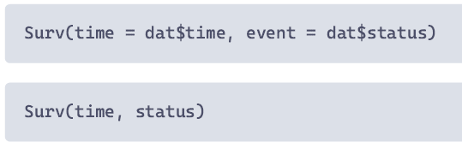
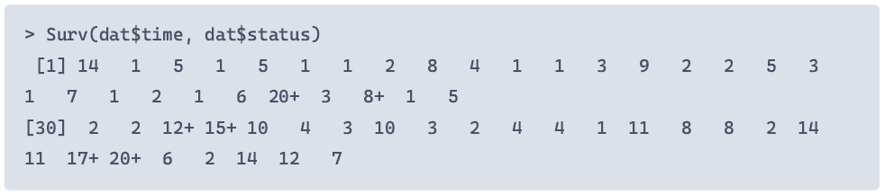
H. zea survival – Survival Object
Surv() function from ‘survival’ package
Creates a Surv object with time-to-event data.
Basic structure: Surv(time, event)
Censored observations are marked with +
R Code
Section: #2

Slide 31
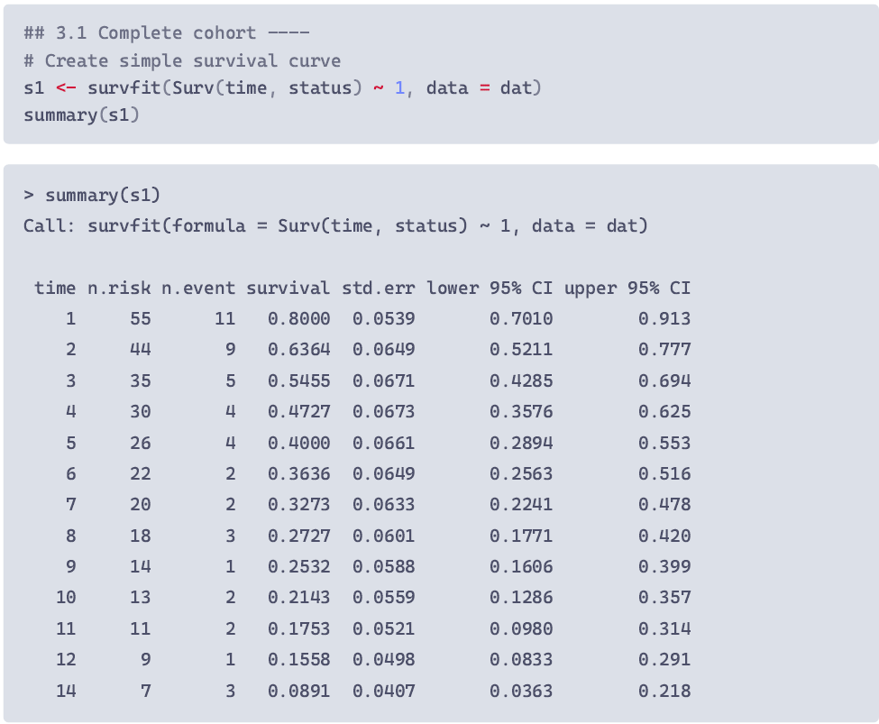
H. zea survival – KM survival curves
R Code
Section: #3
survfit() function from ‘survival’ package
generates Kaplan-Meier estimates for survival over time
Basic structure: survfit(Surv(time, event) ~ variable)
calculates survival curve for entire cohort
One line for each timepoint for which events were recorded

Slide 32
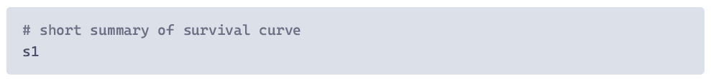
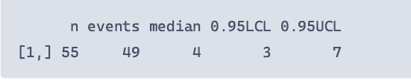
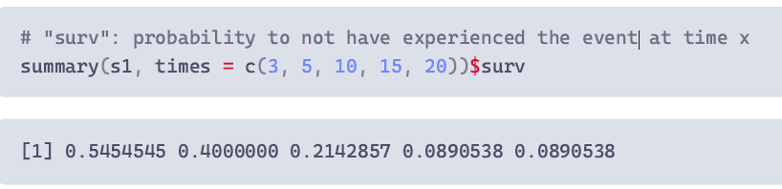
H. zea survival – KM survival curves
Estimated survival an be used to calculate probability of survival beyond specific times:

Slide 33
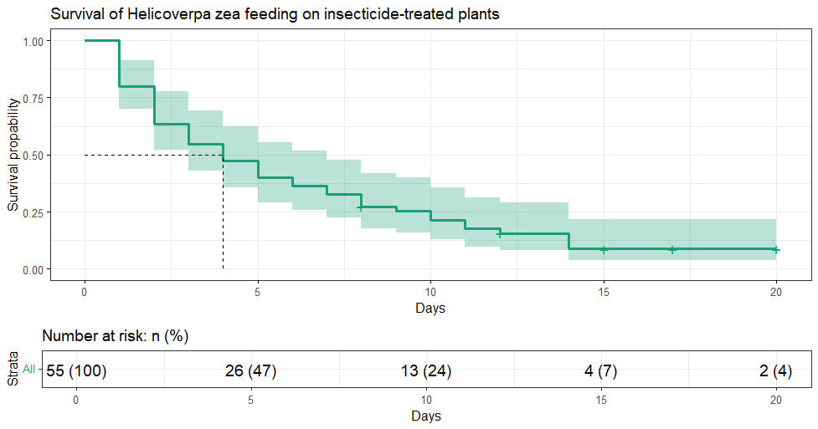
H. zea survival – KM survival curves
Censored observations are marked with +
Median survival time

Slide 34
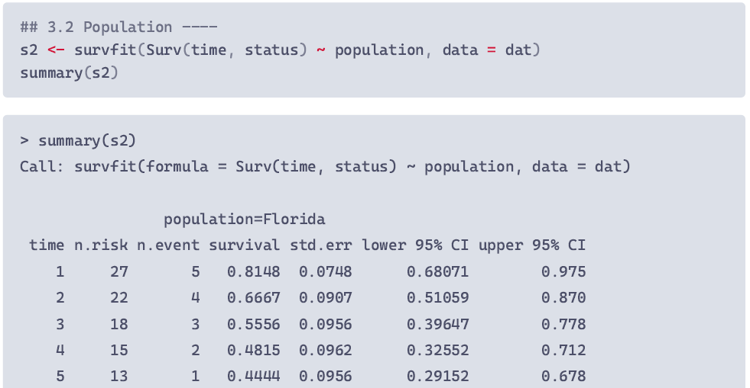

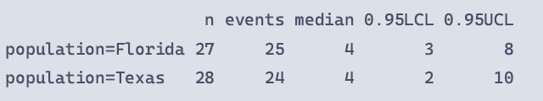
H. zea survival – Population Differences
Summary tables are now given for each population
Short summary of s2

Slide 35
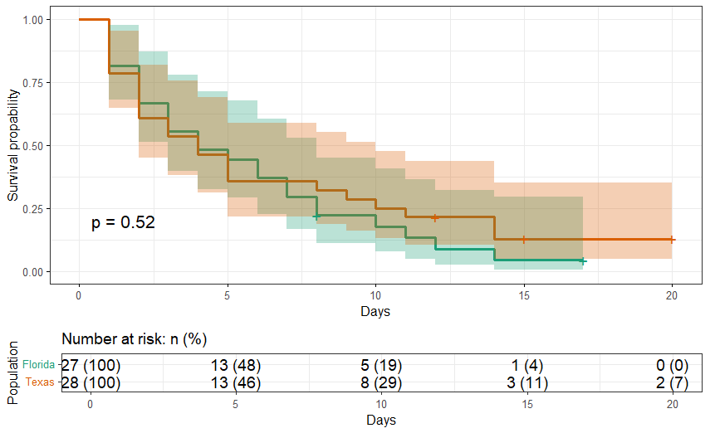
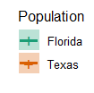
H. zea survival – KM survival curves
Are survival curves different?
Log-rank test: survdiff(Surv(time, status) ~ population, data = dat)

Slide 36
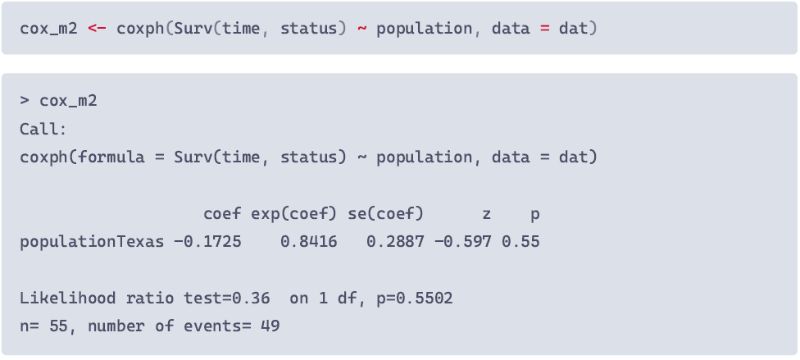
H. zea survival – Cox PH Model
R Code
Section: #4
coxph() function from ‘survival’ package
Can fit a model with multiple covariates, estimates hazard
Basic structure: coxph(Surv(time, event) ~ variable)
exp(coef): HR of group (TX) relative to reference (FL)
HR = 0.842, or 84.2% of the hazard for FL,
i.e. 15.8% reduction in hazard (ns!)

Slide 37
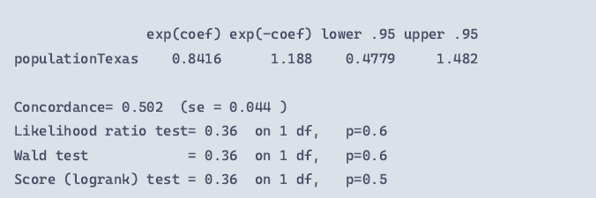
H. zea survival – Cox PH Model
coxph() function from ‘survival’ package
Can fit a model with multiple covariates, estimates hazard
Basic structure: coxph(Surv(time, event) ~ variable)
Concordance: measure of predictive accuracy (0.5 = as good as random)
Global model tests assess model fit

Slide 38

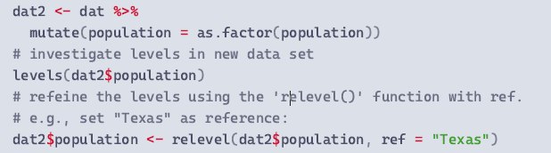
H. zea survival – Changing the Reference
Reference by default: first group listed for each variable
For categorical variables: determined by alphabetical order
To change the reference to x:
Turn variable into a factor
Redefine levels and assign reference with relevel(…, ref=“x“)
1
2
1
2

Slide 39
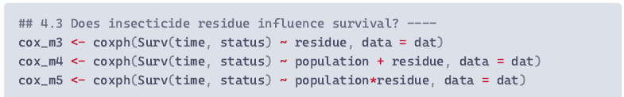
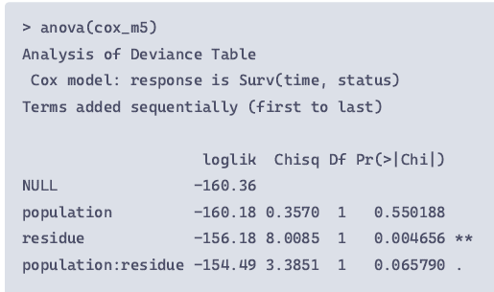
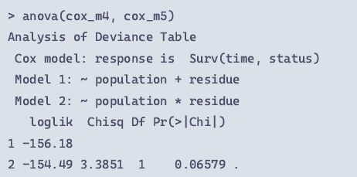
H. zea survival – Cox PH Model
Based on your research question and study system you may want to keep covariates in your model even if n.s.
Does insecticide residue influence survival?
Use anova() to assess the contribution of each term
or to compare different cox models

Slide 40
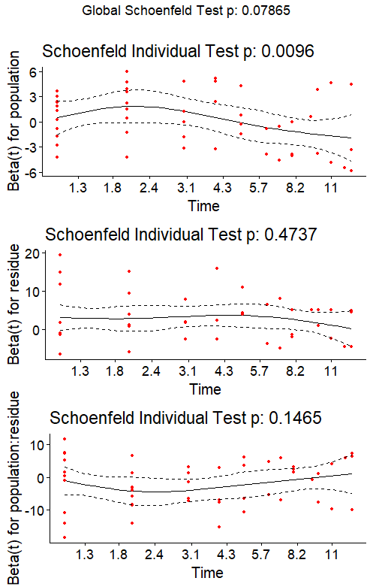
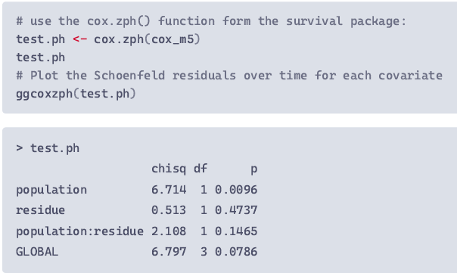
H. zea survival – Cox PH Assumptions
Non-informative censoring
Proportional hazard
Linearity (continuous covariates)

Slide 41
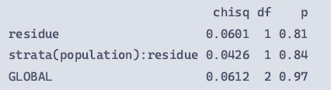
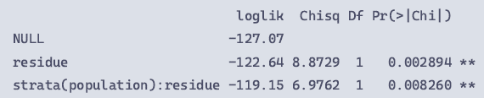
H. zea survival – Violation of PH assumption
To resolve:
stratification (categorical variables)
adding a covariate*time interaction
Use stratification only for confounding variables that are not investigated for main effect! Stratification allows base hazard h₀ to differ between groups
cox.zph(cox_m5b)
Contribution of stratified variable not assessed

Slide 42
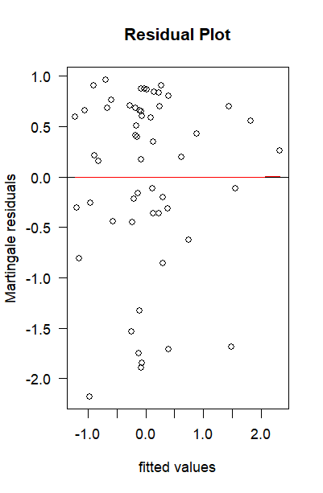
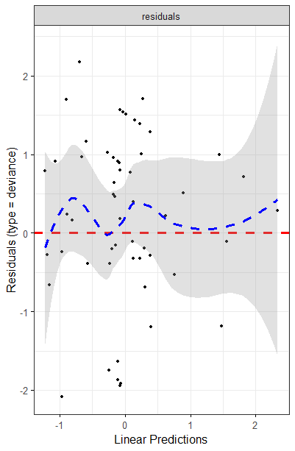
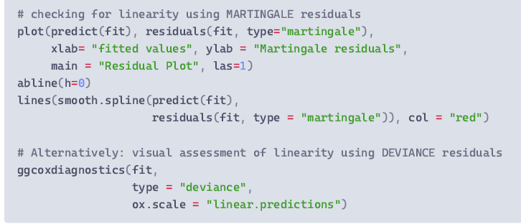
H. zea survival – Linearity of Covariates
Non-informative censoring
Proportional hazard
Linearity of continuous covariate

Slide 43
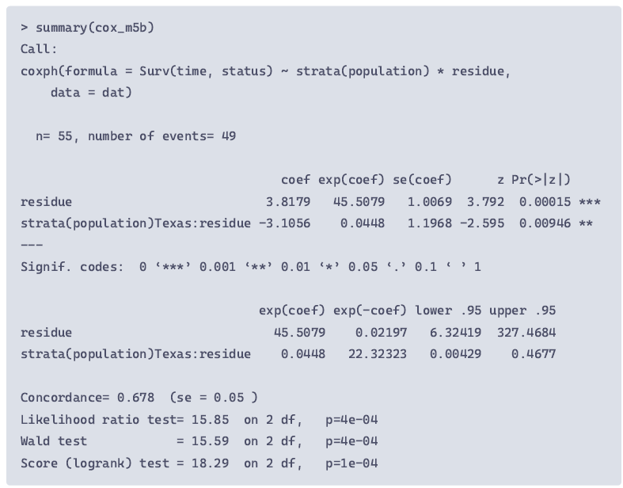

H. zea survival –Interpretation
1
Residue effect on FL population: HR ≈ 45 → very strong effect
1
For each 1-unit increase in residue, the hazard of death increases by a factor of ~45

Slide 44
H. zea survival –Interpretation
1
Residue effect on FL population: HR ≈ 45.5 → very strong effect
Residue mod. for TX: HR ≈ 0.045 → weaker effect in Texas
1
2
2
Net effect of residue on Texas population:
β_{res(TX)} = β_{res(FL)} + β_{TX:res}
3.8179 + (–3.1056) ≈ 0.7123
→ HR: exp(0.7123) ≈ 2.04

Slide 45
H. zea survival –Interpretation
1
Residue effect on FL population: HR ≈ 45 → very strong effect
Residue mod. for TX: HR ≈ 0.045 → weaker effect in Texas
Model performance
concordance: ~0.678 → moderate predictive accuracy
1
2
2
3
3
***
similar, LRT more robust for smaller sample sizes

Slide 46
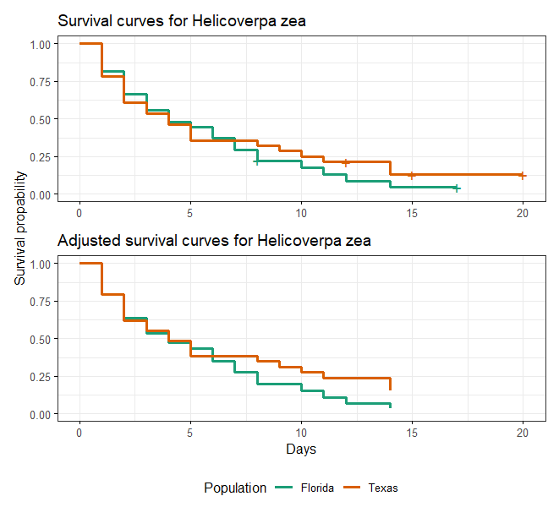
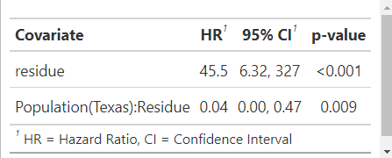
H. zea survival – Adjusted Survival
Adjusted survival curves present expected survival curves for each sub-populations
R Code
Section: #5

